Slide 1
Image based breed recognition for cattle of India
CSE7302- University Project
Review-4
Batch Number: ISE_02
Under the Supervision of,
Mr. John Bennet J
Assistant Professor
School of Computer Science and Engineering
Presidency University
Roll Number 20221ISE0032 20221ISE0062 | Student Name Aditya V S Chiranthan T C Nadig
Name of the Program: Information Science and Engineering
Name of the HOD: Dr. Gopal K Shyam
Name of the Program Project Coordinator: Ms. Sumita Guddin

Slide 2
Content
Abstract
Introduction
Literature Survey
Problem Definition
Objectives
Existing Methods and Drawbacks
Block Diagram
Metho
Modules
Results
Future Enhancements
Timeline
References

Slide 3
Abstract:
India has a wide variety of cattle and buffalo breeds that play an important role in agriculture and dairy farming. Correctly identifying these breeds is essential for breeding programs, disease control, and livestock management. However, traditional breed identification is usually done by experts and farmers, which can be time-consuming and sometimes inaccurate. This project proposes an image-based breed recognition system for Indian cattle and buffaloes using computer vision and deep learning techniques. Images of animals are collected and processed to extract important visual features such as face shape, skin pattern, horn structure, and body texture. A convolutional neural network (CNN) model is trained to classify different breeds automatically. The proposed system aims to provide fast, accurate, and user-friendly breed identification using images captured from mobile phones or cameras. This approach can help farmers, veterinarians, and researchers in making better decisions and supports the digital transformation of livestock management in India.

Slide 4
Introduction
India has a wide diversity of indigenous cattle and buffalo breeds used for dairy and
agriculture.
Breed identification is currently performed through:
Manual visual inspection
Traditional knowledge
Expert consultation
This approach leads to:
Misclassification of breeds
Difficulty in identifying crossbreeds
Lack of scalable digital solutions
With advancements in Deep Learning, automated image-based classification has become feasible.

Slide 5
Literature Survey
A Comprehensive Analysis of Classic Machine Learning and Deep Learning Modeling for Breed Recognition of Bananas
Link: https://ieeexplore.ieee.org/document/11239069
Existing Work | Method | Model | Research Gap | Proposed Plan
Earlier research on banana breed recognition mainly depended on manual inspection by experts, which is slow, costly, and subjective. Researchers introduced image processing and traditional machine learning techniques. | Collect banana images of different breeds. Preprocess images Extract features: Manually for classic ML Automatically for deep learning Train multiple models separately | Support Vector Machine (SVM) K-Nearest Neighbors (KNN) Random Forest Convolutional Neural Networks (CNN) Transfer Learning models | Works only on banana breed images, not transferable directly. Images are mostly clean and well-captured and cannot handle multiple objects in one image. Not tested in real-world agricultural conditions | Collect real-world images with complex backgrounds. Use object detection or segmentation before classification. Extend approach to animal or cattle breed recognition.

Slide 6
Literature Survey
A Vision-Based Cattle Recognition System Using TensorFlow for Livestock Water Intake Monitoring.
Link: https://ieeexplore.ieee.org/document/9924566
Existing Work | Method | Model | Research Gap | Proposed Plan
Earlier systems for livestock monitoring mainly used manual observation, sensors, or RFID tags to check cattle activity and water intake. Very few works used computer vision, and those that did were limited to controlled environments. | Camera installed near the water trough. Continuous video capture. Extract frames from video. Recognize cattle using image-based techniques. | TensorFlow-based deep learning model. CNN for image recognition. Simple object detection and classification pipeline. | Works mainly for monitoring, not breed identification Accuracy depends heavily on camera position Cannot handle multiple cattle clearly No breed classification or segmentation | Extend recognition to breed identification Improve performance in crowded farm environments for breed analysis

Slide 7
Literature Survey
Cattle Breed Detection and Categorization Using Image Processing and Machine Learning
Link: https://ieeexplore.ieee.org/document/10088381
Existing Work | Method | Model | Research Gap | Proposed Plan
Traditional cattle identification relies on ear tags, RFID chips, and manual inspection, which are intrusive and error-prone. | Image collection Image preprocessing Feature extraction Classification using Support Vector Machine (SVM) | Support Vector Machine (SVM). Handcrafted features based on facial morphology and body shape. | Relies on manual feature extraction, limiting scalability. Cannot handle occlusion, background noise, or pose variation well. No deep feature learning. Limited robustness under real farm conditions. | Replace SVM with CNN-based feature extraction. Use instance segmentation (Mask R-CNN) before classification. Train with multi-angle and real-world datasets. Automate breed recognition without manual preprocessing

Slide 8
Literature Survey
Contour Extraction of Individual Cattle From an Image Using Enhanced Mask R-CNN Instance Segmentation Method
Link: https://ieeexplore.ieee.org/document/9400819
Existing Work | Method | Model | Research Gap | Proposed Plan
Earlier systems struggled with: Overlapping cattle Complex farm backgrounds Traditional segmentation methods failed under poor lighting and clutter. | Input farm images Preprocessing and augmentation and segmentation using Enhanced Mask R-CNN. Contour extraction for individual cattle | Enhanced Mask R-CNN. Backbone CNN (ResNet-based) Improved mask generation for precise boundary detection | Focuses only on segmentation, not breed recognition. No classification or identity mapping. High computational cost. Not optimized for mobile or low-resource environments | Combine Mask R-CNN + Breed Classification CNN Optimize with lighter backbones (MobileNet ) Extend system for breed + identity recognitio

Slide 9
Literature Survey
Cow Face Recognition with Noise Labels Using Vision Transformer
Link: https://ieeexplore.ieee.org/document/10348318
Existing Work | Method | Model | Research Gap | Proposed Plan
Most cow face recognition methods rely on CNNs and assume that training labels are clean. However, in real farms, labels often contain errors (noise), which reduces accuracy. | Collect cow face images Introduce noisy labels intentionally Use Vision Transformer (ViT) to learn global features Apply noise-robust learning strategy Identify individual cows | Vision Transformer (ViT) Noise-robust loss functions Attention-based feature learning | High computation requirement Needs large datasets Focuses on identity recognition, not breed recognition No background removal or segmentation | Combine segmentation + transformer Use lightweight transformer variants Extend from identity recognition to breed recognition Improve usability in real farm environments

Slide 10
Literature Survey
Dog Breed Detection using YOLOv7 and WOA CNN
Link: https://ieeexplore.ieee.org/document/10543599
Existing Work | Method | Model | Research Gap | Proposed Plan
Earlier dog breed detection systems used only CNNs, which struggled when the dog was not clearly visible. Object detection was not included, reducing accuracy in real-world images. | Detect dog using YOLOv7 Crop detected region Extract features using CNN Optimize CNN using Whale Optimization Algorithm (WOA) Classify dog breed | YOLOv7 – object detection CNN – classification WOA – optimization | Designed only for dogs High computation cost No segmentation Not tested in farm conditions | Adapt YOLO-based detection for cattle Add segmentation for better accuracy Replace heavy models with lightweight ones Apply approach to cattle breed identification

Slide 11
Literature Survey
Identifying the Optimal Deep Learning Based Image Recognition Technique for Dog Breed Detection
Link: https://ieeexplore.ieee.org/document/10307245
Existing Work | Method | Model | Research Gap | Proposed Plan
CNN-based models (AlexNet, VGG, ResNet) widely used Transfer learning improves performance Major issues: overfitting and lack of interpretability | Dataset preparation (Udacity Dogs – 133 breeds) Image resizing and augmentation Transfer learning with pretrained CNNs Performance comparison | VGG19 Inception V3 Xception MobileNet V2 | Not domain-specific (dogs ≠ cattle) No segmentation before classification No real-world noisy dataset handling Interpretability issues | Adapt best-performing CNNs to cattle datasets Add instance segmentation before classification Introduce explainability (Grad-CAM) Reduce overfitting using domain-specific augmentation

Slide 12
Literature Survey
Graph Synthesis for Pig Breed Classification From Muzzle Images
Link: https://ieeexplore.ieee.org/document/9535496
Existing Work | Method | Model | Research Gap | Proposed Plan
Some previous research also explored biometric-based cattle identification, where specific body parts such as the face, muzzle, or body patterns were used to recognize animals. | Capture cattle images using cameras Preprocess images Extract visual features from cattle images Train a deep learning model using labeled images Test the system to recognize or classify cattle | Convolutional Neural Network (CNN) Deep learning framework for training and testing Image-based classification approach | Works mainly with single cattle images Performance decreases in real farm environments No clear separation of cattle from background Limited handling of multiple cattle in one frame Does not fully support breed-level classification for diverse cattle types | Use object detection to locate cattle in images Apply segmentation to separate individual cattle Extend the system to accurate breed recognition Deploy as a real-time web or mobile application

Slide 13
Literature Survey
Research on Multi-View Cattle Facial Recognition Algorithm Based on Feature Matching
Link: https://ieeexplore.ieee.org/document/11199799
Existing Work | Method | Model | Research Gap | Proposed Plan
Traditional cattle identification methods such as ear tags, RFID, and microchips are harmful or unreliable. Deep learning models give good accuracy but require retraining whenever new cattle are added, which is costly. | Capture cattle face images from multiple angles Extract key points using Super Point-booster Enhance features using feature-booster network Match images using improved Super Glue (Efficient Glue) | Super Point-booster (feature extraction) Feature-Booster Network Efficient Glue (Improved Super Glue) for matching | Matching time slightly increases Works mainly for face recognition, not breed classification Complex architecture Not end-to-end classification system | Use feature matching output for breed classification Combine with CNN-based classifier Reduce complexity using lightweight models Apply to Indian cattle breeds

Slide 14
Literature Survey
Identification of Cattle’s Breed Type by Processing Image using Deep Learning Models
Link: https://ieeexplore.ieee.org/document/10859520
Existing Work | Method | Model | Research Gap | Proposed Plan
Traditionally, cattle breed identification was done manually based on physical appearance. Later, machine learning models were introduced but required manual feature extraction. Recent works use deep learning, but most focus on limited datasets and clean images. | Collect cattle images Preprocess images (resize, normalize) Train deep learning models Extract features automatically Classify cattle breed | CNN-based deep learning models Transfer learning approaches Image classification networks | Works well only with single cattle images No handling of background noise Limited number of cattle breeds No real-time or farm-level deployment | Use real farm images Add cattle detection before classification Increase number of supported breeds Improve robustness in different lighting and backgrounds

Slide 15
Literature Survey
Automatic Cattle Identification based on Fusion of Texture Features Extracted from Muzzle Images
Link: https://ieeexplore.ieee.org/document/8352400
Existing Work | Method | Model | Research Gap | Proposed Plan
Earlier cattle identification systems mostly used ear tags and microchips, but these methods are costly, easy to tamper with, and may hurt animals. | Extract Gabor features at different scales and orientations Reduce feature size using PCA Normalize features using Z-score Classify cattle identity using SVM | Gabor Wavelet Transform tLBP (Transition Local Binary Pattern) PCA (Principal Component Analysis) SVM (Support Vector Machine) | Works only on static muzzle images Performance may drop with movement and lighting changes Identifies individual cattle, not breed Requires clear close-up muzzle images | Extend from individual identification to breed recognition Use automatic detection instead of manual muzzle capture Combine with deep learning models for robustness

Slide 16
Literature Survey
Video-Based Analysis of Cattle Behaviors: Improved Classification Using FlowEQ Transform
Link: https://ieeexplore.ieee.org/document/10475331
Existing Work | Method | Model | Research Gap | Proposed Plan
Most earlier cattle behavior monitoring systems depended on manual observation or wearable sensors, which are time-consuming and costly. Some video-based approaches existed, but they struggled with noise, lighting variation, and background movement. | Capture continuous cattle video Extract frames from video Apply FlowEQ transform to enhance motion patterns Extract motion-based features | FlowEQ Transform – enhances motion information Feature extraction from motion patterns | Focuses only on behavior analysis, not breed recognition Cannot identify individual cattle Does not include object detection or segmentation | Combine behavior analysis with cattle identification Add object detection and segmentation Extend system to support breed classification

Slide 17
Literature Survey
Automatic Cattle Identification based on Multi-Channel LBP on Muzzle Images
Link: https://ieeexplore.ieee.org/document/8693161
Existing Work | Method | Model | Research Gap | Proposed Plan
Traditionally, buffalo type identification was done manually by experts, which is slow and depends on experience. Some earlier computer vision works used simple image processing and classical machine learning. | Annotate images with buffalo types Apply image preprocessing Use YOLO object detection algorithm to detect buffalo | YOLO (You Only Look Once) algorithm Single-stage object detection model Deep learning–based real-time detection framework | Limited number of buffalo types supported Accuracy depends on dataset quality No segmentation for precise shape extraction | Increase dataset size and diversity Add segmentation after detection Extend system to cattle and buffalo breed recognition Improve robustness in real farm environments

Slide 18
Literature Survey
Identification of Different Types of Buffalo Using YOLO Algorithm Based on Computer Vision
Link: https://ieeexplore.ieee.org/document/10428773
Existing Work | Method | Model | Research Gap | Proposed Plan
Earlier cattle identification methods used ear tags and microchips, which can be lost, damaged, or cause discomfort. Researchers later explored muzzle images, since muzzle patterns are unique like human fingerprints. | Divide images into small sub-regions Extract texture features using multi-channel LBP Create histograms for each sub-image Classify cattle using SVM | Multi-Channel Local Binary Pattern (LBP) Principal Component Analysis (PCA) Support Vector Machine (SVM) | Requires clear, close-up muzzle images Not suitable for moving cattle Identifies individual cattle, not breed Not designed for real-time farm usage No object detection or segmentation | Automate muzzle detection using deep learning Extend identification to breed recognition Combine texture features with CNN models Handle real farm lighting and motion conditions

Slide 19
Literature Survey
A hybrid deep learning based robust framework for cattle identification
Link: https://ieeexplore.ieee.org/document/10088414
Existing Work | Method | Model | Research Gap | Proposed Plan
Earlier cattle identification methods mainly relied on ear tags, RFID, tattooing, and branding. These methods often fail due to tag loss, fraud, animal discomfort, and poor scalability. | Data Collection & Augmentation Image Denoising Image Enhancement Feature Extraction Classification | CDAE (Convolutional Denoising Autoencoder) LS-GAN (Least Squares GAN) Xception Network (Extreme Inception Network) CNN (1D) | Works only on face and muzzle images, not full body Identifies individual cows, not breed classification Dataset size is still limited to 20 cows Not tested in highly crowded or outdoor uncontrolled farm scenes | Expand system to breed recognition of cattle and buffaloes Use object detection (YOLO) for automatic animal detection Handle real-time video input from farms

Slide 20
Problem Definition
India has multiple indigenous cattle and buffalo breeds with similar physical characteristics.
Current breed identification methods rely on:
Manual observation
Traditional knowledge
Veterinary expertise
Challenges in existing system:
High chances of misclassification
Difficulty in identifying crossbreeds
Lack of standardized digital verification
Limited expert availability in rural areas
Time-consuming and non-scalable process
There is no widely accessible automated system that can accurately classify cattle and
buffalo breeds from images.

Slide 21
Objectives
To develop an image-based automated system for cattle and buffalo breed recognition.
To apply deep learning (CNN) for accurate breed classification.
To support Indian cattle and buffalo breeds.
To reduce dependency on manual breed identification.
To build a scalable and extensible model for future breeds

Slide 22
Existing Methods and Drawbacks
Existing Methods
Manual breed identification by experts
Physical tagging and records
Image processing with handcrafted features
Machine learning models (SVM, KNN)
Biometric identification (muzzle, face).
Drawbacks
Manual methods are time-consuming and subjective
Physical tags can be lost or damaged
Handcrafted features give low accuracy
Biometric methods require close-up images
Most systems are not scalable
Limited focus on Indian breeds

Slide 23
How We Overcome The Existing Drawbacks
Use CNN-based deep learning for automatic feature extraction
No need for physical tags or biometric images
Works with normal images of cattle and buffalo
Supports multiple Indian breeds
Scalable system – new breeds can be added easily
Higher accuracy compared to traditional ML

Slide 24
Proposed Method
Collect cattle and buffalo breed images
Preprocess images (resize, normalize, augment)
Split dataset into training and testing sets
Train CNN-based deep learning model
Predict breed from input image

Slide 25
Feasibility Study
Technical Feasibility
Uses Python, TensorFlow/Keras
Runs on standard systems with GPU/CPU
Economic Feasibility
Open-source tools used
No specialized hardware required
Operational Feasibility
Easy to use: image upload - breed prediction
Reduces need for livestock experts
Scalability Feasibility
New breeds can be added by updating dataset
Model can be retrained easily

Slide 26
Block Diagram
Dataset Upload(.ZIP)
Dataset Extraction and organization.
EfficientNet with Transfer Learning
Model Training
Model Saving
(.pth file)

Slide 27
Flow Diagram
Image Input
Dataset
Image Preprocessing
Load Model
Breed Prediction
Result

Slide 28
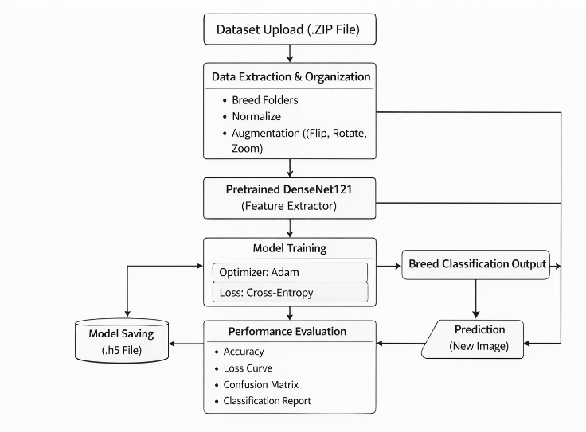
Block Diagram

Slide 29
Modules
Dataset Collection Module
Image Preprocessing Module
Feature Extraction Module
Model Training Module
Breed Prediction Module
Result Visualization Module

Slide 30
Software and Hardware Requirements:
Software Requirements
Operating System: Windows / Linux
Programming Language: Python
Frameworks: TensorFlow
Image Processing: OpenCV
Tools: VS Code, Jupyter Notebook
Hardware Requirements
Processor: Intel i5
RAM: Minimum 8 GB
Storage: Minimum 30 GB
Internet Connection

Slide 31
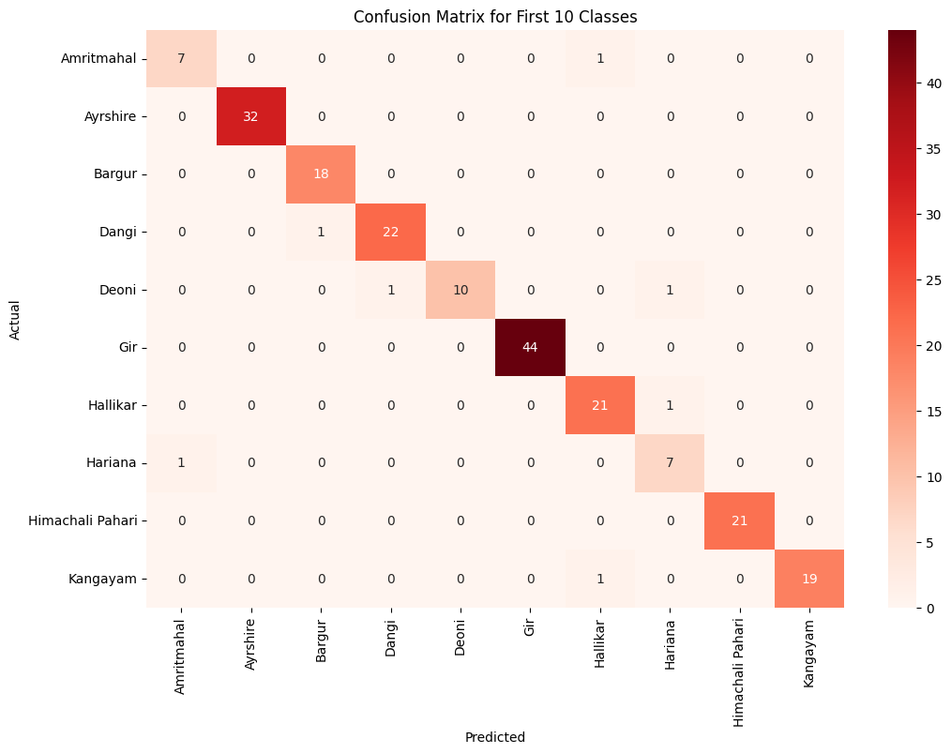
Results
Confusion Matrix – Class 1-10

Slide 32
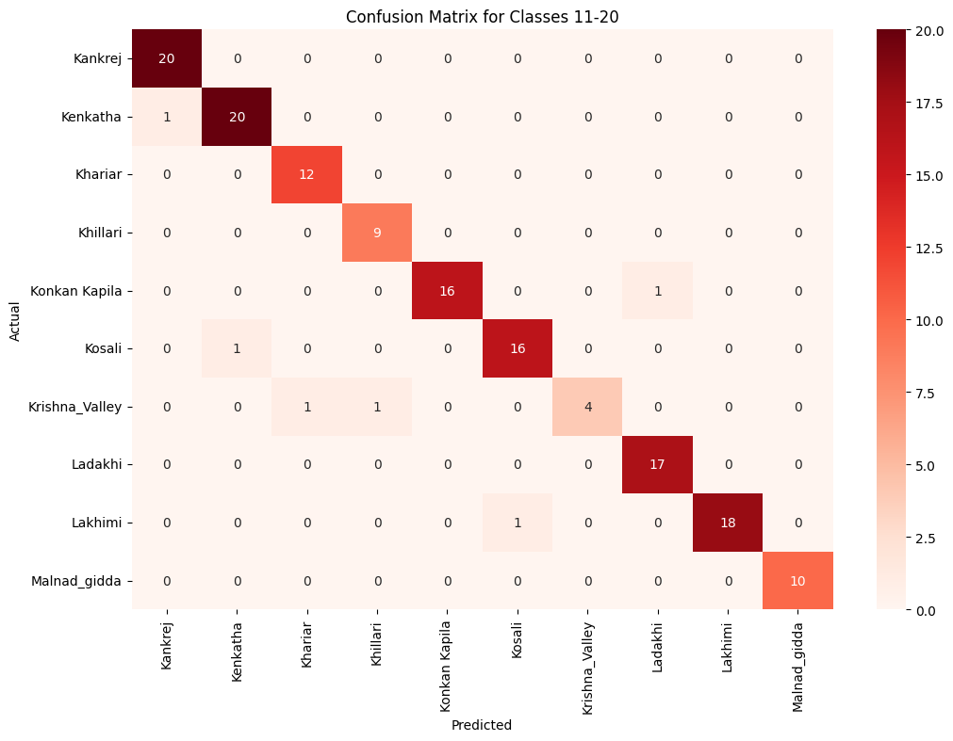
Results
Confusion Matrix – Class 11-20

Slide 33
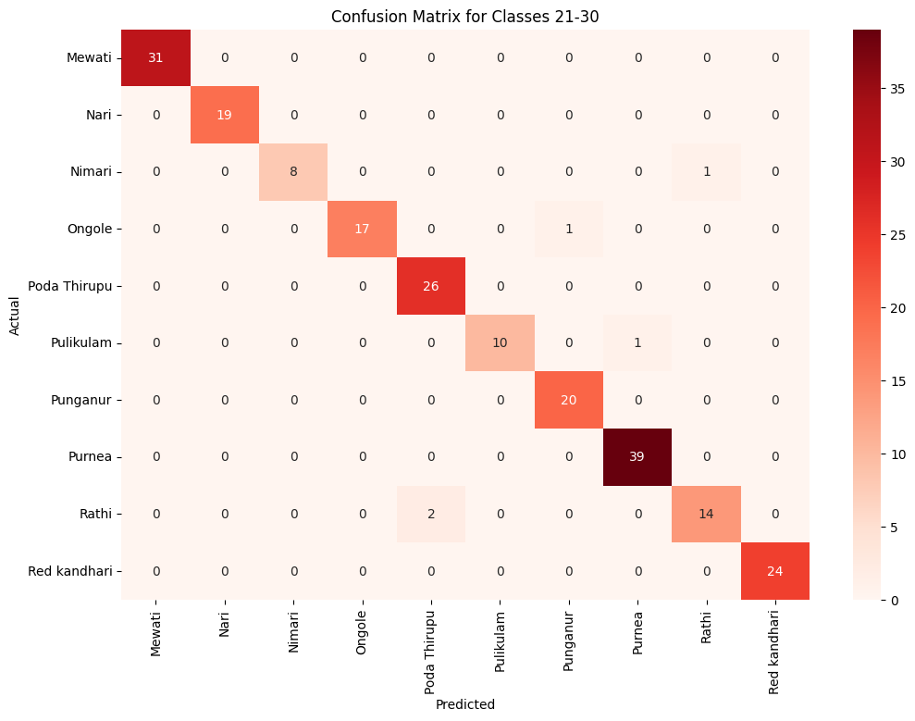
Results
Confusion Matrix – Class 21-30

Slide 34
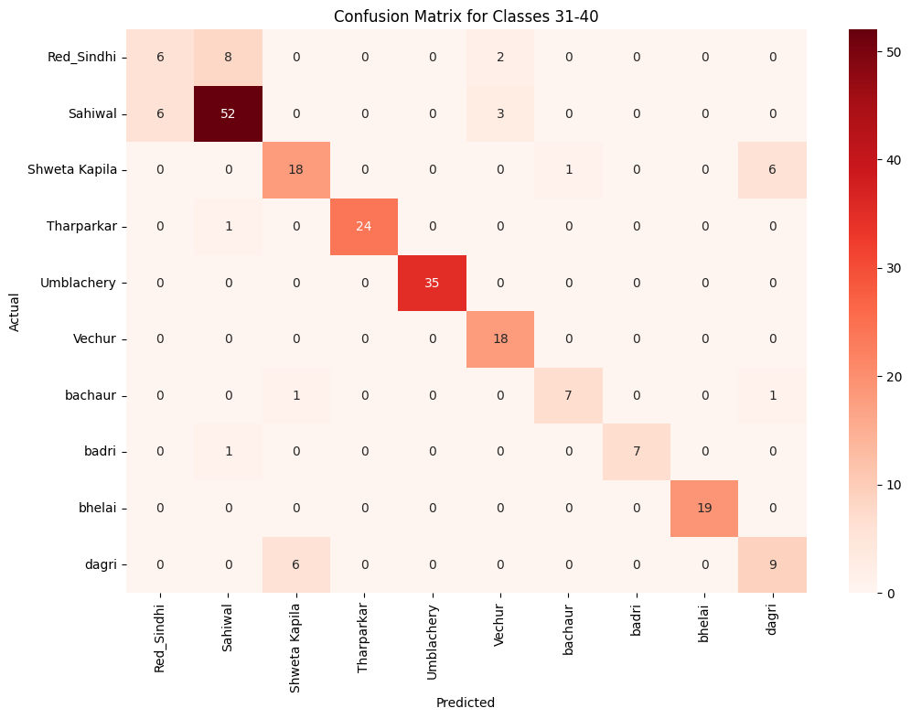
Results
Confusion Matrix – Class 31-40

Slide 35
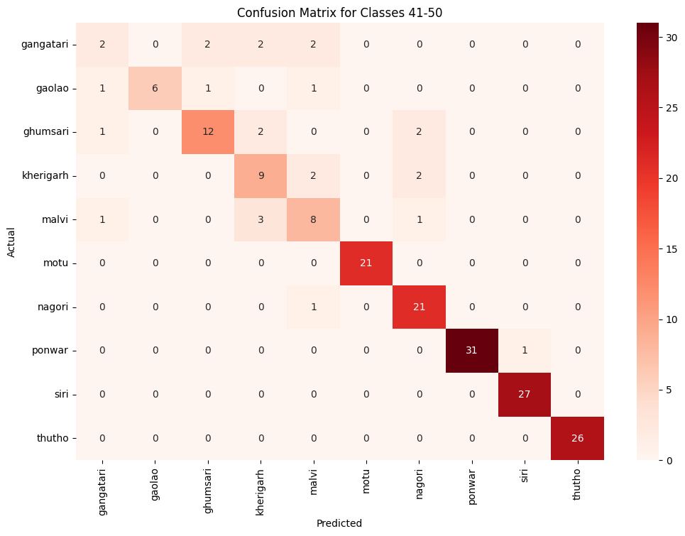
Results
Confusion Matrix – Class 41-50

Slide 36
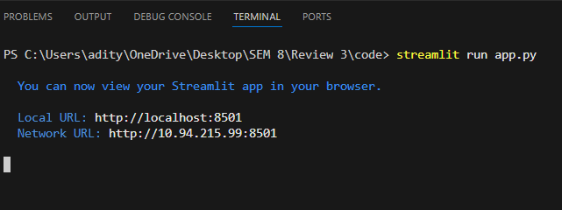
Results
Executing the main file

Slide 37
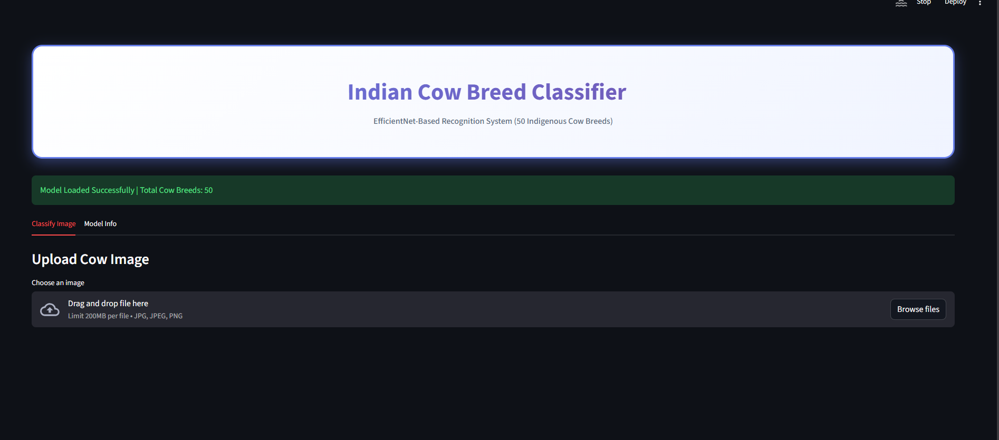
Results-Main Page

Slide 38
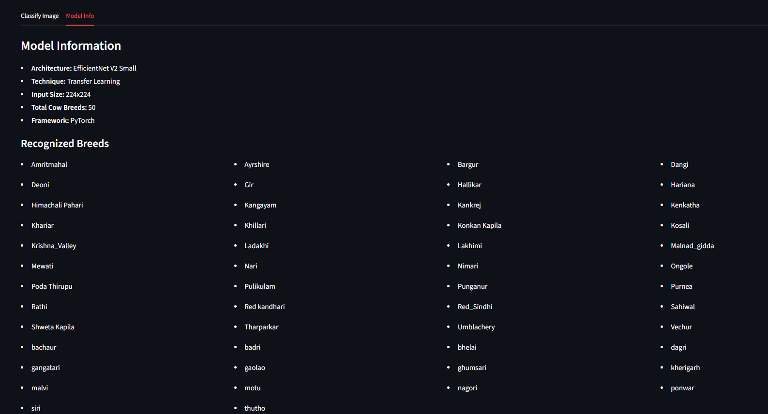
Results-Model Info

Slide 39
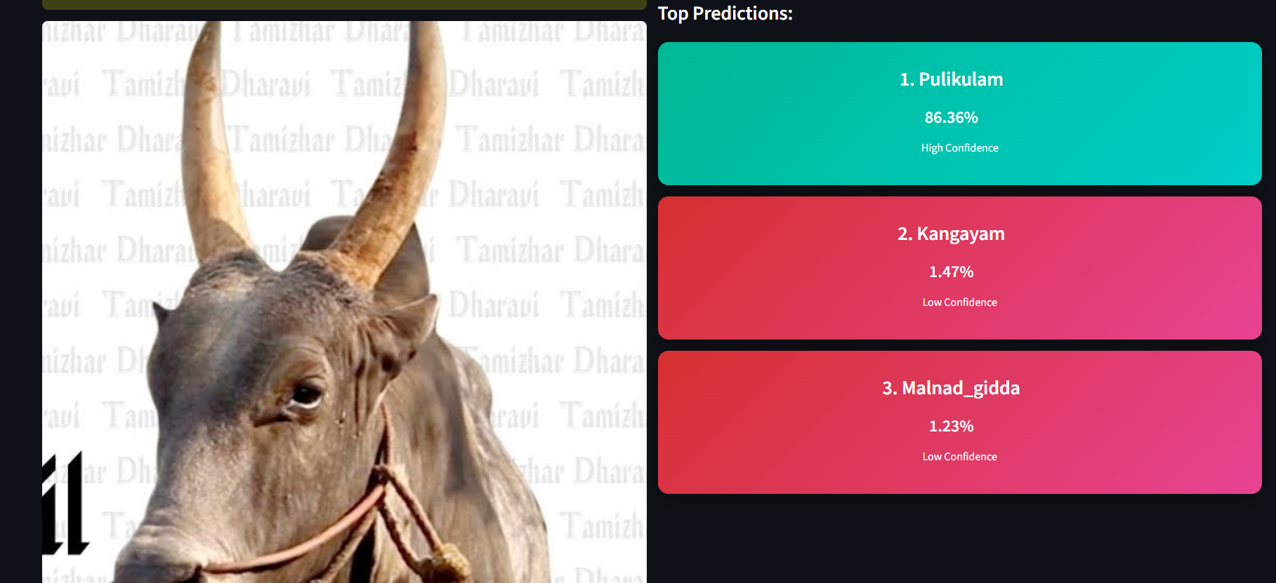
Results - Breed Prediction (Pulikulam)

Slide 40
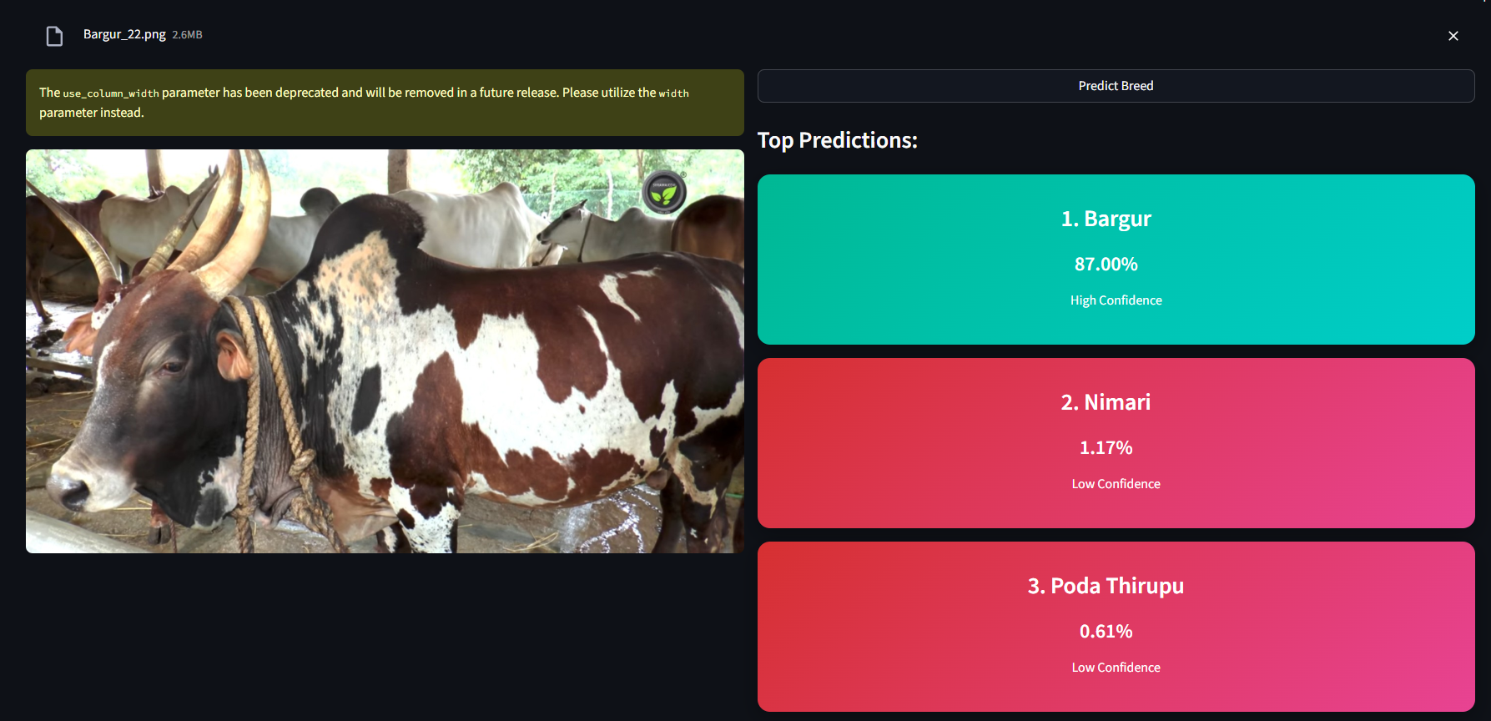
Results-Breed Prediction (Bargur)

Slide 41
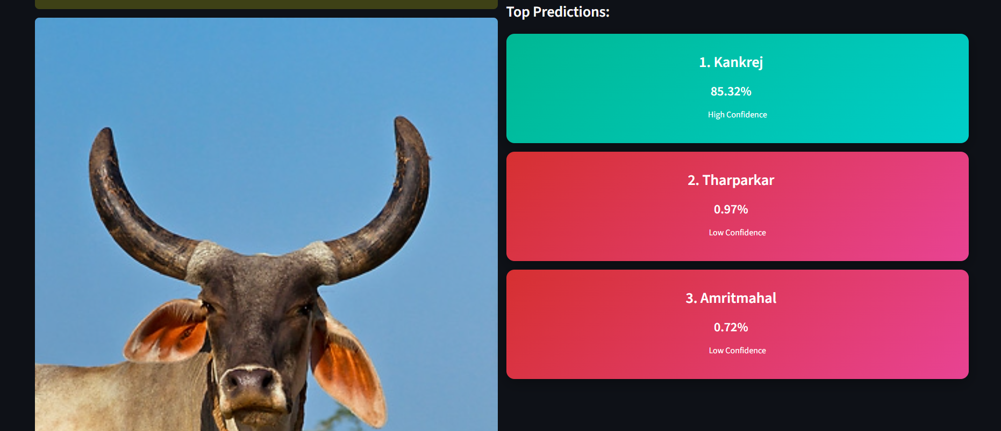
Results- Breed Prediction(Kankrej)

Slide 42
Future Enhancements
In future work, the dataset will be expanded by adding more indigenous cattle breeds, Additional buffalo breeds will also be incorporated to enhance classification coverage and ensure balanced distribution across categories.
Further the number of images per breed will be significantly increased to improve model generalization.
Data collection will consider variations in lighting conditions, backgrounds, camera angles, and seasonal changes to make the model more robust and suitable for real-world deployment.
A comparison between the similar breeds will be displayed below the predicted breed.

Slide 43
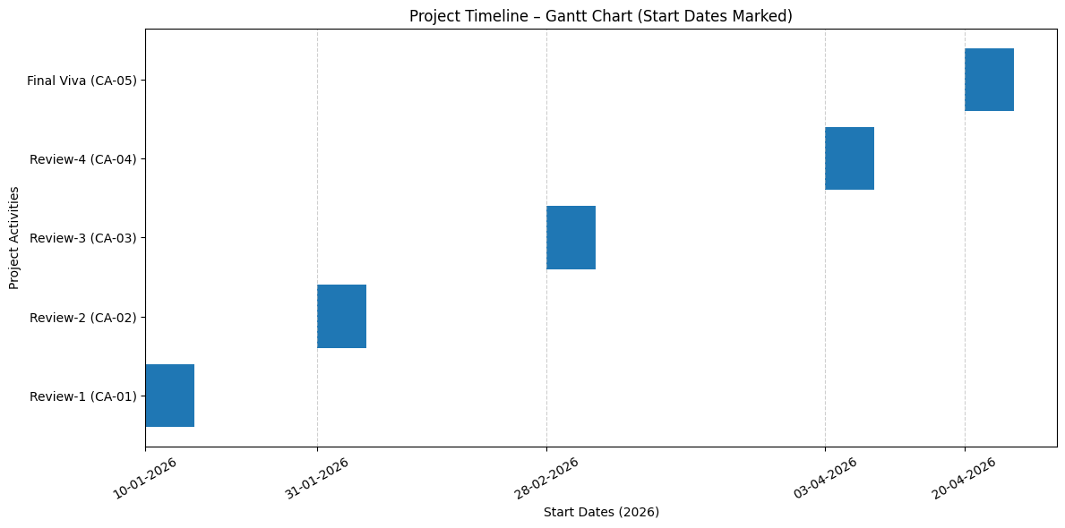
Timeline of the Project (Gantt Chart)

Slide 44
Github Link
https://github.com/aadityaa2611/ISE_02-University-Project

Slide 45
References (IEEE Paper format)
S. Chakraborty, K. Karthik and S. Banik, "Graph Synthesis for Pig Breed Classification From Muzzle Images," in IEEE Access, vol. 9, pp. 127240-127258, 2021, doi: 10.1109/ACCESS.2021.3111957
Link: https://ieeexplore.ieee.org/document/9535496
A. Biglari and W. Tang, "A Vision-Based Cattle Recognition System Using TensorFlow for Livestock Water Intake Monitoring," in IEEE Sensors Letters, vol. 6, no. 11, pp. 1-4, Nov. 2022, Art no. 5501404, doi: 10.1109/LSENS.2022.3215699.
Link: https://ieeexplore.ieee.org/document/9924566
R. -W. Bello, A. S. A. Mohamed and A. Z. Talib, "Contour Extraction of Individual Cattle From an Image Using Enhanced Mask R-CNN Instance Segmentation Method," in IEEE Access, vol. 9, pp. 56984-57000, 2021, doi: 10.1109/ACCESS.2021.3072636.
Link: https://ieeexplore.ieee.org/document/9400819

Slide 46
References (IEEE Paper format)
M. A. Rahman, M. A. Raihan, M. Shorif Uddin, M. Hasan and M. T. Habib, "A Comprehensive Analysis of Classic Machine Learning and Deep Learning Modeling for Breed Recognition of Bananas," in IEEE Access, vol. 13, pp. 194562-194579, 2025, doi: 10.1109/ACCESS.2025.3631557
Link: https://ieeexplore.ieee.org/document/11239069
N. R. Duraiswami, S. Bhalerao, A. Watni and C. N. Aher, "Cattle Breed Detection and Categorization Using Image Processing and Machine Learning," 2022 International Conference on Advancements in Smart, Secure and Intelligent Computing (ASSIC), Bhubaneswar, India, 2022, pp. 1-6, doi: 10.1109/ASSIC55218.2022.10088381. Link: https://ieeexplore.ieee.org/document/10088381
S. C. Iyer and N. M. Shekokar, "Identifying the Optimal Deep Learning Based Image Recognition Technique for Dog Breed Detection," 2023 14th International Conference on Computing Communication and Networking Technologies (ICCCNT), Delhi, India, 2023, pp. 1-10, doi: 10.1109/ICCCNT56998.2023.10307245.
Link: https://ieeexplore.ieee.org/document/10307245

Slide 47
References (IEEE Paper format)
C. Bhanuprakash and V. N. V, "Identification of Cattle's Breed Type by Processing Image Using Deep Learning Models," 2024 International Conference on Integrated Intelligence and Communication Systems (ICIICS), Kalaburagi, India, 2024, pp. 1-7, doi: 10.1109/ICIICS63763.2024.10859520.
Link: https://ieeexplore.ieee.org/document/10859520
Singh, R. Kothari and V. Arulalan, "Dog Breed Detection using YOLOv7 and WOA-CNN," 2024 10th International Conference on Communication and Signal Processing (ICCSP), Melmaruvathur, India, 2024, pp. 1477-1482, doi: 10.1109/ICCSP60870.2024.10543599
Link: https://ieeexplore.ieee.org/document/10543599
H. Zhao, P. Li, Z. Chen, K. Guo, Y. Chen and C. Su, "Cow Face Recognition with Noise Labels Using Vision Transformer," 2023 IEEE 4th International Conference on Pattern Recognition and Machine Learning (PRML), Urumqi, China, 2023, pp. 93-98, doi: 10.1109/PRML59573.2023.10348318
Link: https://ieeexplore.ieee.org/document/10348318

Slide 48
References (IEEE Paper format)
Z. Zheng, B. Wen and Z. Weng, "Research on Multi-View Cattle Facial Recognition Algorithm Based on Feature Matching," 2025 IEEE 8th International Conference on Signal Processing and Machine Learning (SPML), Hohhot, China, 2025, pp. 5-9, doi: 10.1109/SPML66318.2025.11199799. Link: https://ieeexplore.ieee.org/document/11199799
J. -W. Chae, H. -S. Sim, C. -W. Lee, C. -S. Choi and H. -C. Cho, "Video-Based Analysis of Cattle Behaviors: Improved Classification Using FlowEQ Transform," in IEEE Access, vol. 12, pp. 42860-42867, 2024, doi: 10.1109/ACCESS.2024.3379277
Link: https://ieeexplore.ieee.org/document/10475331
W. Kusakunniran, A. Wiratsudakul, U. Chuachan, S. Kanchanapreechakorn and T. Imaromkul, "Automatic cattle identification based on fusion of texture features extracted from muzzle images," 2018 IEEE International Conference on Industrial Technology (ICIT), Lyon, France, 2018, pp. 1484-1489, doi: 10.1109/ICIT.2018.8352400. Link: https://ieeexplore.ieee.org/document/8352400

Slide 49
References (IEEE Paper format)
W. Kusakunniran and T. Chaiviroonjaroen, "Automatic Cattle Identification based on Multi-Channel LBP on Muzzle Images," 2018 International Conference on Sustainable Information Engineering and Technology (SIET), Malang, Indonesia, 2018, pp. 1-5, doi: 10.1109/SIET.2018.8693161.
Link: https://ieeexplore.ieee.org/document/8693161
J. R. Butu, I. Nurtanio and A. W. Paundu, "Identification of Different Types of Buffalo Using YOLO Algorithm Based on Computer Vision," 2023 3rd International Conference on Intelligent Cybernetics Technology & Applications (ICICyTA), Denpasar, Bali, Indonesia, 2023, pp. 159-164, doi: 10.1109/ICICyTA60173.2023.10428773.
Link: https://ieeexplore.ieee.org/document/10428773
V. S. P. Gunda, H. Gulla, V. Kosana and S. Janapati, "A hybrid deep learning based robust framework for cattle identification," 2022 International Conference on Advancements in Smart, Secure and Intelligent Computing (ASSIC), Bhubaneswar, India, 2022, pp. 1-5, doi: 10.1109/ASSIC55218.2022.10088414
Link: https://ieeexplore.ieee.org/document/10088414

Slide 50


